Slide 1
Some facts about non-parametric tests
When to use non-parametric tests?
What do they measure?
What assumptions do they make?

Slide 2
When to use non-parametric tests?
When the normality conditions are not met (Moore & McCabe)
  When the distribution of (at least) one variable is not normal
  When the number of observations (N) is too small to assess normality adequately
  When the distributions do not have the same shape

Slide 3
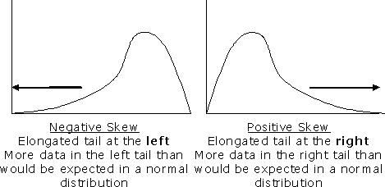
Compare:

Slide 4
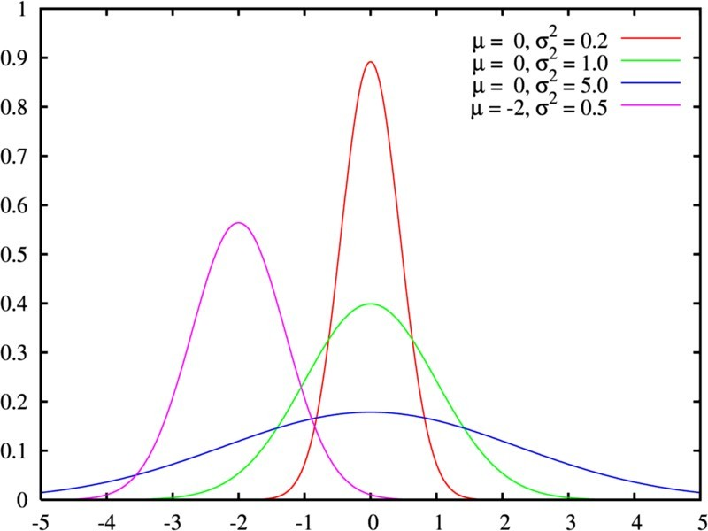
Compare:

Slide 5
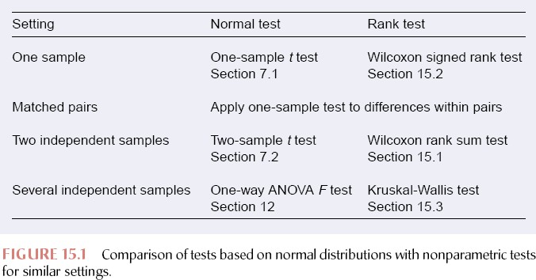
Moore & McCabe Chapter 14, 5th Edition

Slide 6
What do non-parametric tests measure?
Parametric tests make inferences about the mean of a sample
When a distribution is strongly skewed→the center of the population is better represented by the median
→ Non-parametric tests make hypotheses about the median instead of the mean

Slide 7
Recall:
Mean µ=∑xi/n
Median is the midpoint of a distribution, the number such that half the observations are smaller and the other half are larger.
→ Mean is more sensitive to outliers than the median

Slide 8
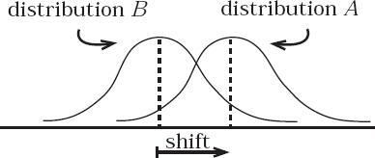

Slide 9
But:
This is so only if the (two or more) distributions have the same shape (practically impossible)
Actually non-p tests measure whether the values of one distribution are systematically different than the values of the other distribution

Slide 10
Compare:

Slide 11
Hypotheses with non-parametric tests
One-tailed Hypothesis
H₀→ The two distributions are the same
H_{a}→ One distribution has values that are systematically larger
Two-tailed Hypothesis
H₀→ The two distributions are the same
H_{a}→ One distribution has values that are systematically different (larger or smaller) than the other

Slide 12
What assumptions do non- parametric tests make?
They are NOT totally assumption-free tests
The variables must be continuous →
They can take any possible value within a given range
(very often violated assumption!!!)

Slide 13
Tests to be introduced:
Wilcoxon Rank-Sum test (Mann-Whitney test)
Wilcoxon Signed-Rank test
Friedman Anova (x²)

Slide 14
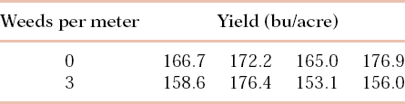
Wilcoxon Rank-Sum test (Mann- Whitney test)-an example
We want to see if weeds have an influence on the amount of yields of corn
Moore & Mc Cabe

Slide 15
Our Hypotheses:
H₀→ There is no difference in yields between plots with weed and weed free plots
H_{a}→ Plots with weed produce systematically fewer yields than weed-free plots

Slide 16
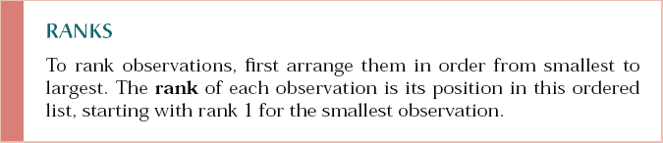
How to perform Wilcoxon Rank Sum test by hand
1) Rank the values

Slide 17

2) Keep track of which sample each value belongs to

Slide 18
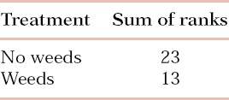
3) Sum the ranks for each sample
If H₀ is true the sum of ranks for each sample should be exactly the same!

Slide 19
The test statistic W
W is the sum of the ranks of the one sample
In this case the sum of ranks for corns with weeds is 23

Slide 20
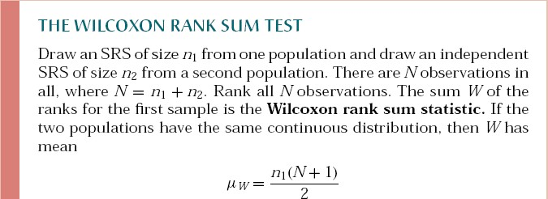
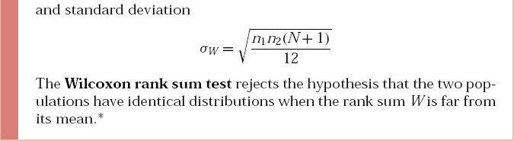
Moore & McCabe

Slide 21
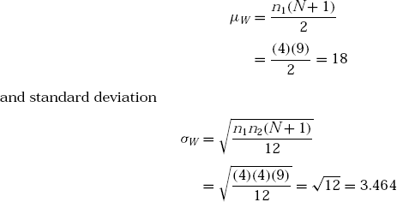
In this case:

Slide 22
Is it significant?
W=23 and µW=18, and σW=3.64
W>µW but only 1.4 SDs [(23-18)/3.64]
→ probably not significant difference
We can calculate it
  By the tables
  By the normal approximation (with continuity correction!!)

Slide 23
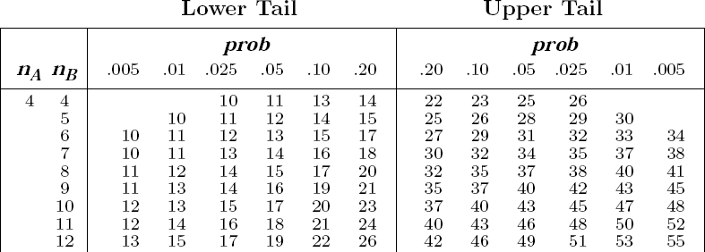

Slide 24

Normal approximation-z-score
P(Z≥1.44)=1-0.9251=0.0749 from the tables of the normal curve

Slide 25
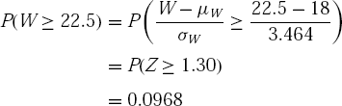
Continuity correction!
Continuity correction assumes that X=23 includes all the values from 22.5 to 23.5
So here we will calculate the z-score of
22.5 since we want to find P(W≥23)

Slide 26
The experimental design
2 Groups
non-fluent patients (N=3)
healthy controls (N=4)
4 conditions
Indicative affirmative (24)
Indicative negative (24)
Subjunctive affirmative (24)
Subjunctive negative (24)

Slide 27
The Greek clause structure (Philippaki-Warburton, 1990;1998)
CP
MoodP
NegP
FutP
AgrP
TenseP
VoiceP
AspectP
VP

Slide 28
Wilcoxon Rank-Sum test (Mann- Whitney test)
Comparison between 2 independent samples – 1 condition (Indicative affirmative)
H₀→ Both groups perform equally
H_{a}→ Controls perform better than patients

Slide 29
Data
Participant | Score
C1 | 24
C2 | 24
C3 | 24
C4 | 24
P1 | 22
P2 | 22
P3 | 23

Slide 30
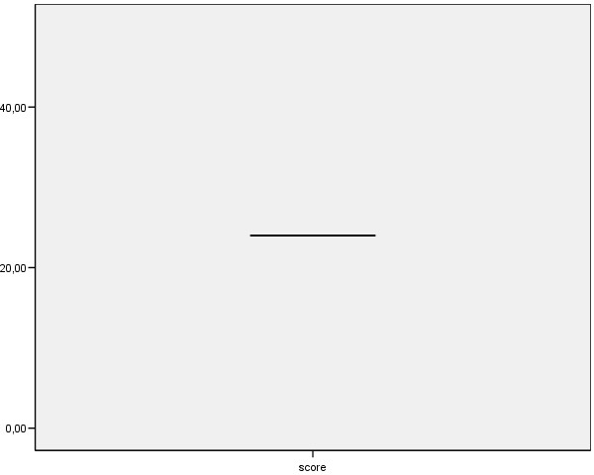
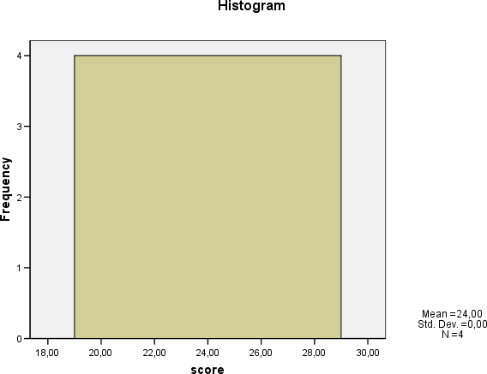
Boxplot
Histogram
Distribution of the controls’scores

Slide 31
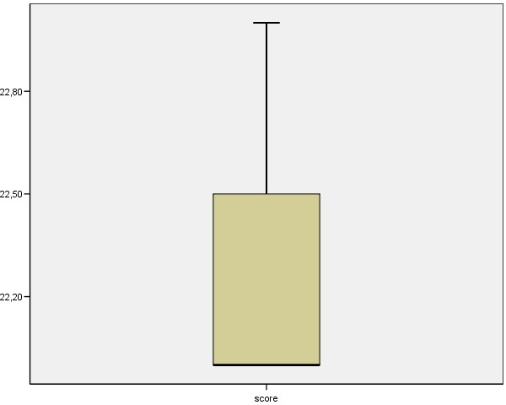
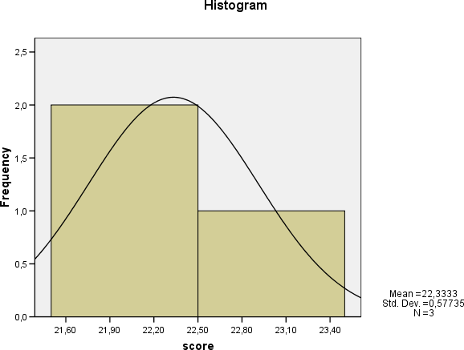
Boxplot
Histogram
Tests of Normality
 | Kolmogorov-Smirnovª |  |  | Shapiro-Wilk
 | Statistic | df | Sig. | Statistic | df | Sig.
score | ,385 | 3 | . | ,750 | 3 | ,000
^{a.} Lilliefors Significance Correction
Distribution of the patients’scores

Slide 32
Ranking
1 | 22 | 23 | 24 | 24 | 24 | 24
1 | 2 | 3 | 4 | 5 | 6 | 7
1.5 1.5
3 5.5 5.5 5.5 5.5

Slide 33
Because we have a lot of ties we must trust a statistics package!
Ties influence the exact distribution of the W and the SD of the W must be adjusted

Slide 34
We should accept the Ha that the control group performed systematically better than the patient group
Ranks
group |  | N | Mean Rank | Sum of Ranks
score | controls | 4 | 5,50 | 22,00
 | patients | 3 | 2,00 | 6,00
 | Total | 7
Test Statistics^{b}
 | score
Mann-Whitney U | ,000
Wilcoxon W | 6,000
Z | -2,366
Asymp. Sig. (2-tailed) | ,018
Exact Sig. [2*(1-tailed Sig.)] | a ,057
Exact Sig. (2-tailed) | ,029
Exact Sig. (1-tailed) | ,029
Point Probability | ,029
Not corrected for ties.
Grouping Variable: group

Slide 35
Friedman’s ANOVA
We want to compare the performance of the aphasic speakers in the 4 condition
1 group k conditions
Hypotheses:
H₀→ Patients perform equally in all 4 condition
H_{a}→ There is a difference in the performance of patients across conditions

Slide 36
The data
scores |  |  |  |  | ranks
 | i.a. | i.n. | s.a. | s.n. | i.a. | i.n. | s.a. | s.n.
P1 | 22 | 18 | 12 | 12 | 4 | 3 | 1.5 | 1.5
P2 | 22 | 18 | 11 | 1 | 4 | 3 | 2 | 1
P3 | 23 | 23 | 0 | 1 | 3.5 | 3.5 | 1 | 2
Sum of Ranks |  |  |  |  | 11.5 | 9.5 | 4.5 | 4.5

Slide 37
The test statistic Fr
⎡
⎢
⎣
12
k
₂ ⎤
∑
F =
R
⎥
⎦
− 3N (k + 1)
r
Nk (k + 1)
j
j = 1
N= sample size, k=number of conditions, Rj=sum of ranks for each condition
P-value from tables of chi-square distribution

Slide 38
Here we have
Fr=7.6, p>0.05, we accept the H0

Slide 39
We should accept the Ha that the perfromance of the patients is different across conditions
Ranks
 | Mean Rank
indicative affirmative | 3,83
indicative negative | 3,17
subjunctive affirmative | 1,50
subjunctive negative | 1,50
Test Statisticsª
N | 3
Chi-Square | 8,143
df | 3
Asymp. Sig. | ,043
Exact Sig. | ,021
Point Probability | ,014
^{a.} Friedman Test

Slide 40
Post hoc
There are differences but between which conditions and which direction do they have?
Wilcoxon signed-rank test
Bonferroni correction (α-level/ number of comparisons=0.05/6=0.008)

Slide 41
Theory of Wilcoxon‘s sign rank test
 | i.a. | i.n. | Diff | sign | Rank | + | -
P1 | 22 | 18 | 4 | + | 1.5 | 1.5
P2 | 22 | 18 | 4 | + | 1.5 | 1.5
P3 | 23 | 23 | 0 | excl
Total |  |  |  |  |  | 3 | 0

Slide 42
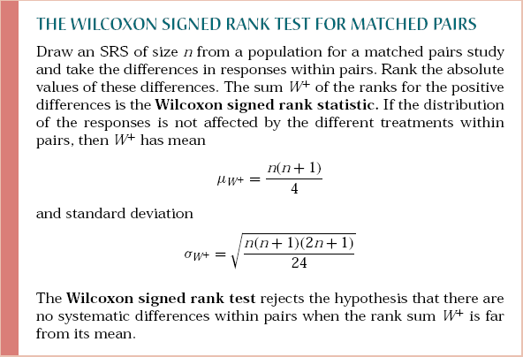

Slide 43
Test Statistics^{b}
Test Statistics^{b}
Test Statistics^{b}
 | subjneg - indaff
Z | -1,604ª
Asymp. Sig. (2-tailed) | ,109
Exact Sig. (2-tailed) | ,250
Exact Sig. (1-tailed) | ,125
Point Probability | ,125
 | indneg - indaff
Z | -1,414ª
Asymp. Sig. (2-tailed) | ,157
Exact Sig. (2-tailed) | ,500
Exact Sig. (1-tailed) | ,250
Point Probability | ,250
 | subjaff - indaff
Z | -1,604ª
Asymp. Sig. (2-tailed) | ,109
Exact Sig. (2-tailed) | ,250
Exact Sig. (1-tailed) | ,125
Point Probability | ,125
Based on positive ranks.
Wilcoxon Signed Ranks Test
Based on positive ranks.
Wilcoxon Signed Ranks Test
Based on positive ranks.
Wilcoxon Signed Ranks Test
Test Statistics^{b}
Test Statistics^{b}
Test Statistics^{b}
 | subjaff - indneg
Z | -1,604ª
Asymp. Sig. (2-tailed) | ,109
Exact Sig. (2-tailed) | ,250
Exact Sig. (1-tailed) | ,125
Point Probability | ,125
 | subjneg - indneg
Z | -1,604ª
Asymp. Sig. (2-tailed) | ,109
Exact Sig. (2-tailed) | ,250
Exact Sig. (1-tailed) | ,125
Point Probability | ,125
 | subjneg - subjaff
Z | -,447ª
Asymp. Sig. (2-tailed) | ,655
Exact Sig. (2-tailed) | 1,000
Exact Sig. (1-tailed) | ,500
Point Probability | ,250
Based on positive ranks.
Wilcoxon Signed Ranks Test
Based on positive ranks.
Wilcoxon Signed Ranks Test
a.
Based on positive ranks.
^{b.} Wilcoxon Signed Ranks Test
No difference could be found between conditions! Recall that Friedman‘s ANOVA was marginally significant!

